Slide 1
Characterizing Schedules based on Serializability
If T1 and T2 are two transactions at the same time, no interleaving of operations are permitted then there are only two possible outcomes
1. Execute all the operations of transaction T1 (in sequence) followed by all the operations of transaction T2 (in sequence).
2. Execute all the operations of transaction T2 (in sequence) followed by all the operations of transaction T1 (in sequence).
A schedule S is serial if, for every transaction T participating in the schedule, all the operations of T are executed consecutively in the schedule. Otherwise, the schedule is called non serial schedule.

Slide 2
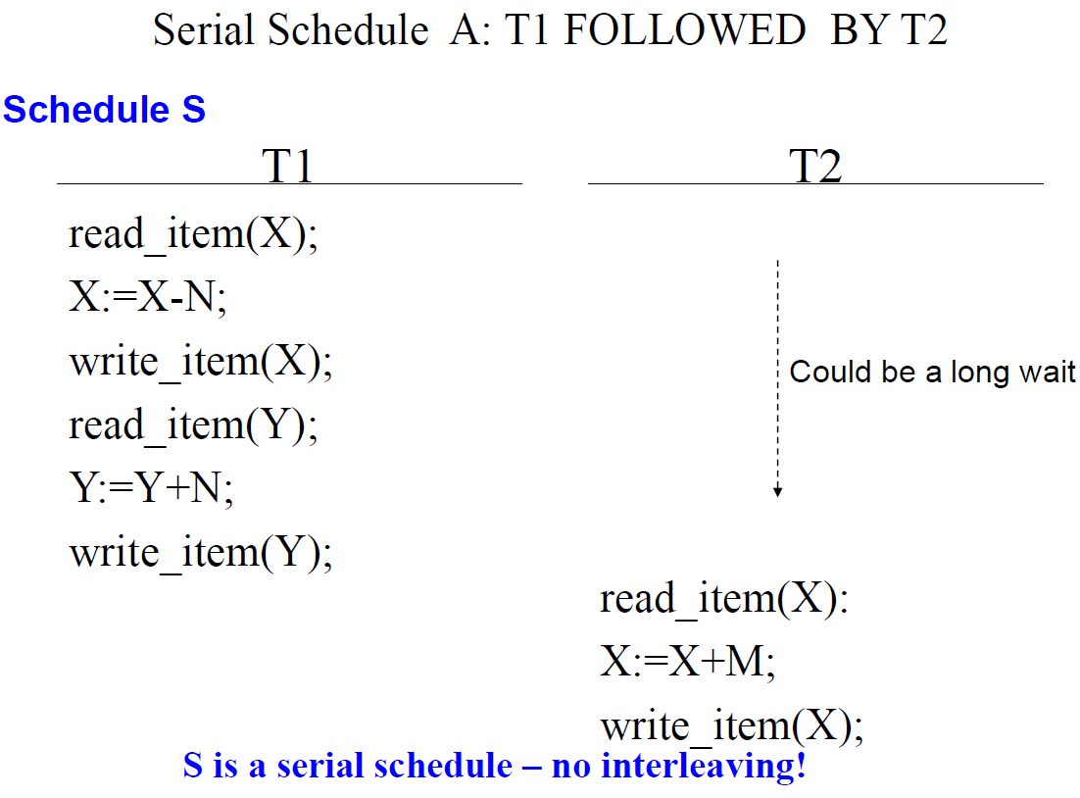
Assume X=90, Y=90, N=3, M=2, then result of schedule S is X=89 and Y= 93

Slide 3
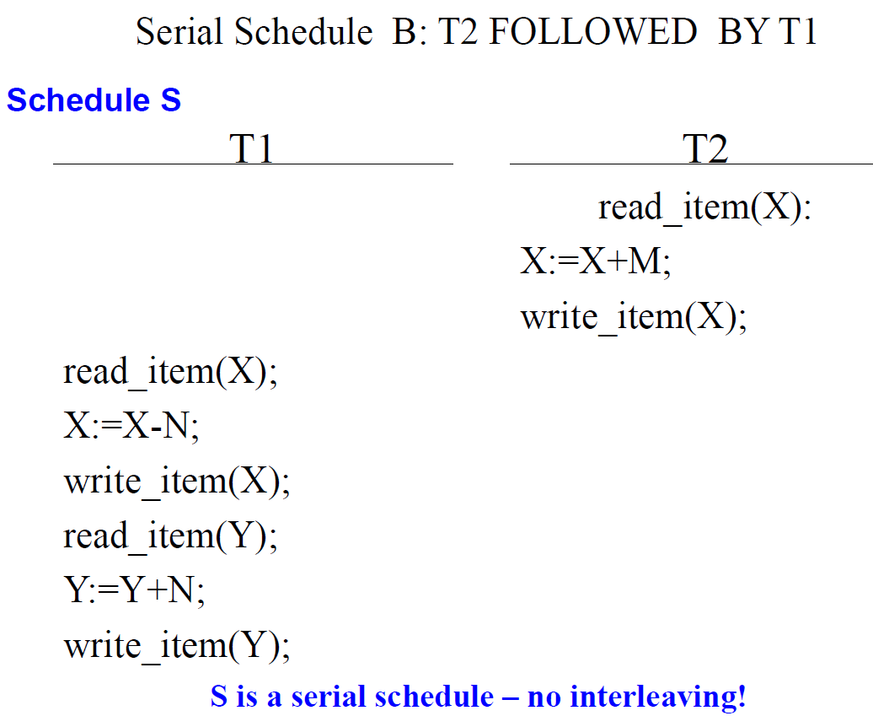
What is the result if we start with T2 Serial schedule
Schedule A and Schedule B are called serial because the operations of Each transaction are executed consecutively ,with out any interleaved operations from the other transaction. In a serial schedule, entire transactions are performed in serial order T1 and then T2.

Slide 4
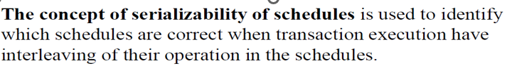
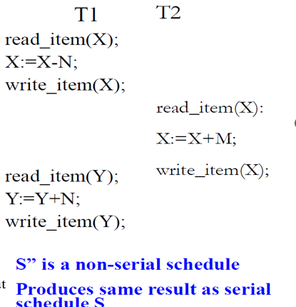
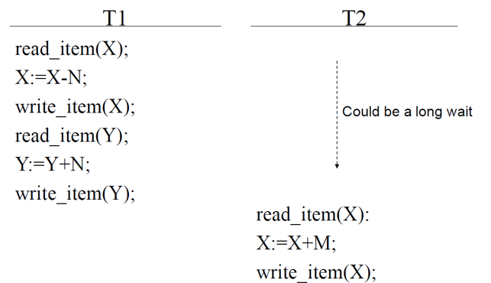
Assume X=90, Y=90, N=3, M=2, then result of schedule S is X=89 and Y= 93

Slide 5
Serializability
• Assumption: Every serial schedule is correct
• Goal: Like to find non-serial schedules which are also correct
• A schedule S of n transactions is serializable if it is equivalent to some serial schedule of the same n transactions.
n! possible serial schedules of n transactions.
• When are two schedules equivalent?
Mainly we focus on conflict equivalent and view equivalent schedules.

Slide 6
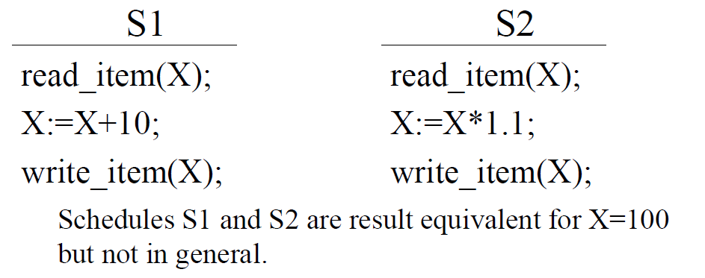
Result Equivalent Schedules
• Two schedules are result equivalent if they produce the same final state of the database. This type of equivalence is given the least importance as two schedules may produce the same result for some set of operations and different results for other sets.
• Problem: May produce same result by accident!
Here in general S1 and S2 are not result equivalent schedules.

Slide 7
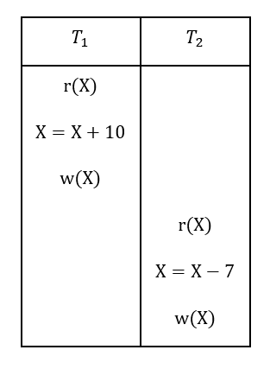
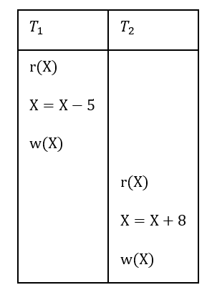
These two schedules that are result equivalent

Slide 8
Conflict Equivalent Schedules
• Two schedules are said to be conflict equivalent if the order of any two conflicting operations is the same in both schedules.
• If two conflicting operations are applied in different orders in two schedules, the effect can be different on the database or on other transactions in the schedule, and hence the schedules are not conflict equivalent.
• For eg if a read and write operation occur in the order r1(X),w2(X) in schedule S1 and in the reverse order w2(x),r1(x) in schedule S2 the r1(x) can be different in the two schedules.
Similarly, if two write operations occur in the order w1(x),w2(x) in s1 and in the reverse order w2(x),w1(x) in s2 The next r(x) operation in two schedules will read different values or the final value of item X in the database will be different.

Slide 9
Schedule A
r1(x);w1(x);r2(x);w2(x);r1(y);w1(y);
Schedule B
r1(x);w1(x); r1(y);w1(y); r2(x);w2(x);
In this Schedule B r1(y)and w1(y) do not conflict with r2(x) and w2(x), since they access different data items. So we can move r2(x);w2(x) before r1(y);w1(y).
Now both schedules are equivalent.
Conflict serializable: A schedule S is said to be conflict serializable if it is conflict equivalent to some serial schedule S’. This ensures that the outcome of the concurrent transactions is equivalent to executing the transactions in a sequential order. Conflict-serializability is a strong criterion for concurrency control.

Slide 10
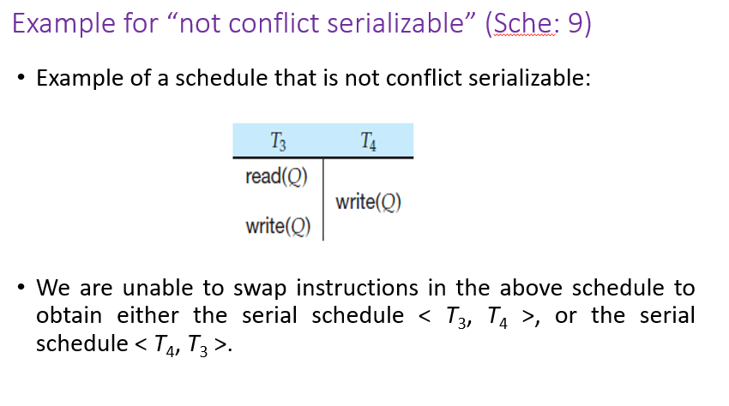

Slide 11
Being serializable is not the same as being serial. Being serializable implies that the schedule is a correct schedule.
– It will leave the database in a consistent state.
– The interleaving is appropriate and will result in a state as if the transactions were serially executed, yet will achieve efficiency due to concurrent execution.
Serializability is hard to check.
– Interleaving of operations occurs in an operating system through some scheduler –Difficult to determine beforehand how the operations in a schedule will be interleaved

Slide 12
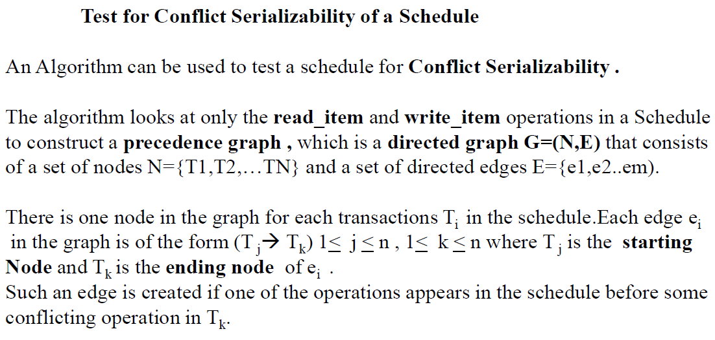

Slide 13
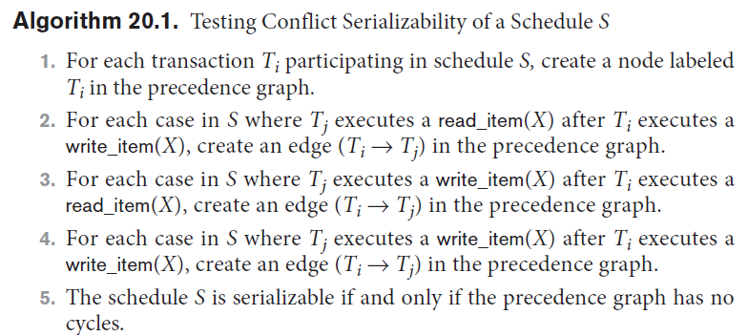

Slide 14
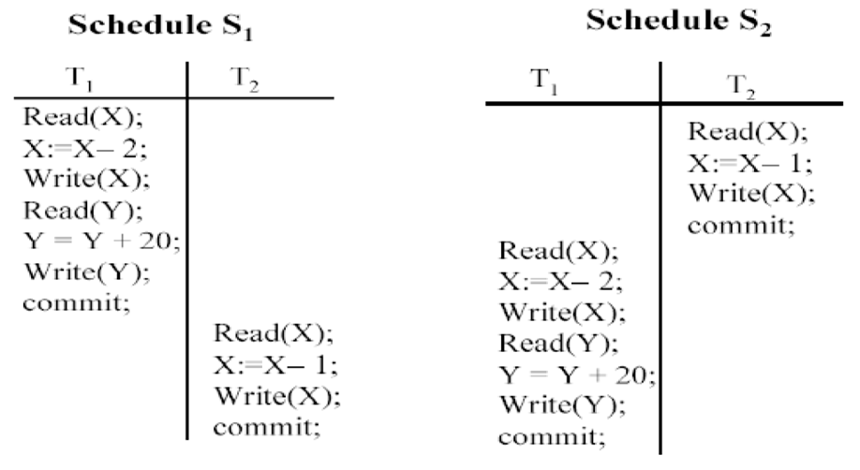
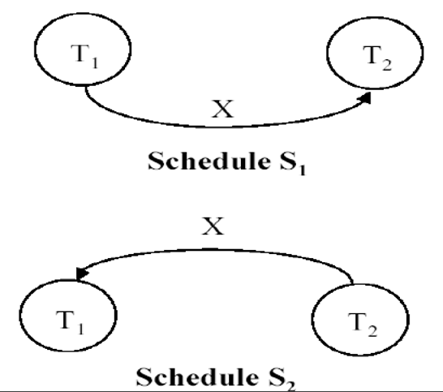

Slide 15
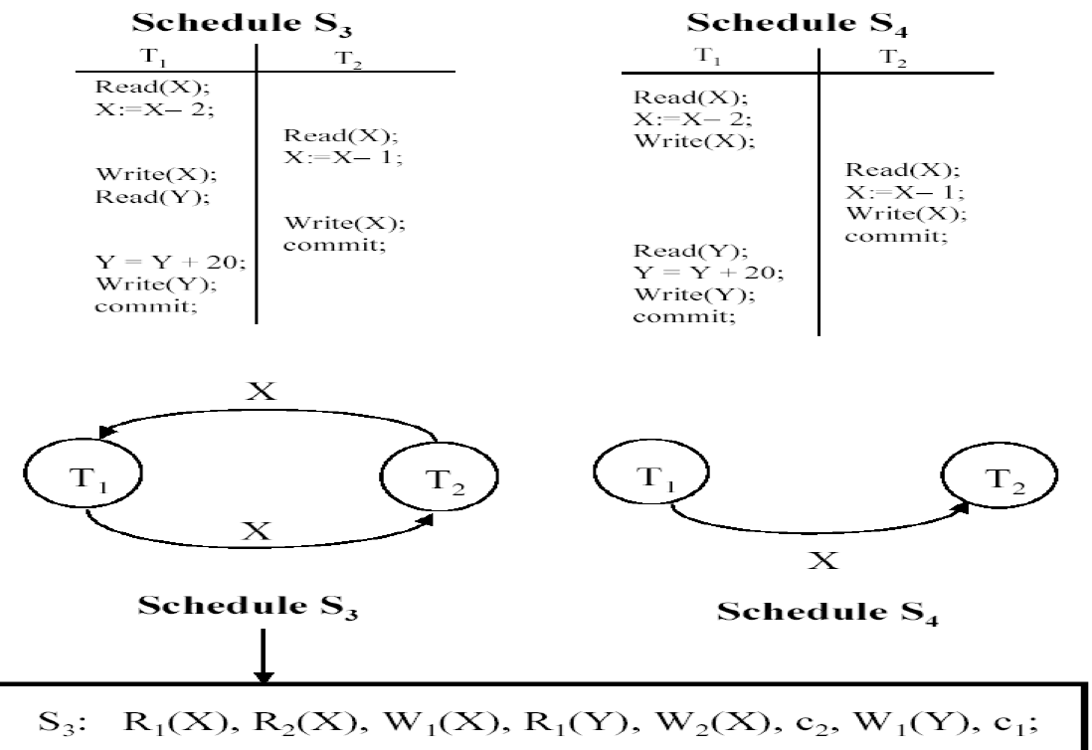

Slide 16
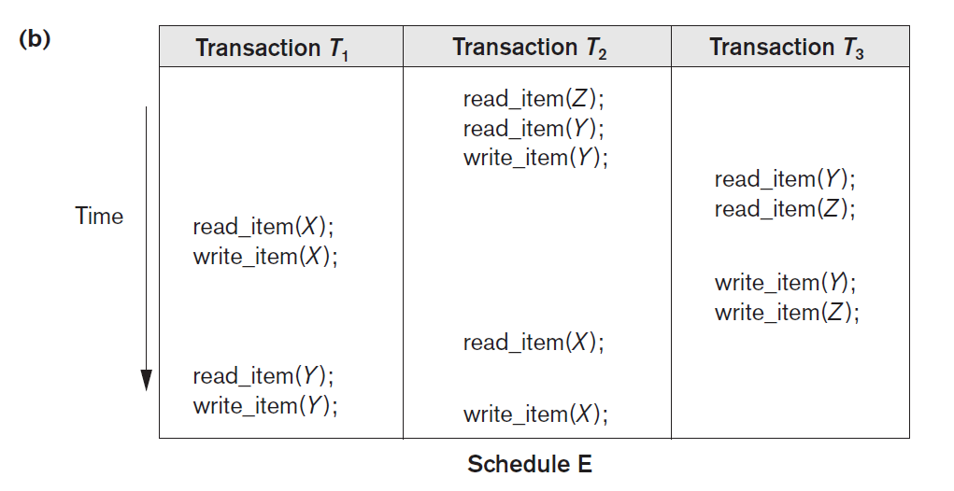

Slide 17
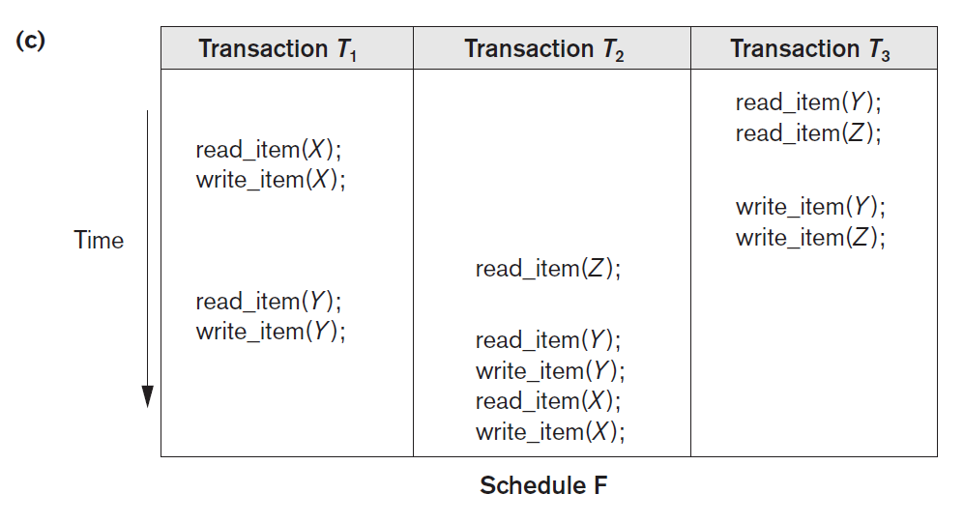

Slide 18
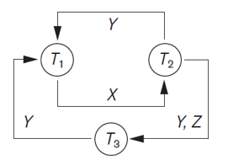
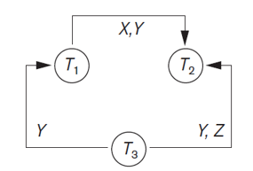

Slide 19
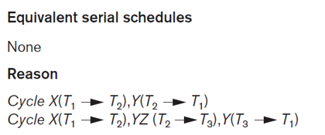
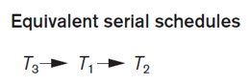

Slide 20
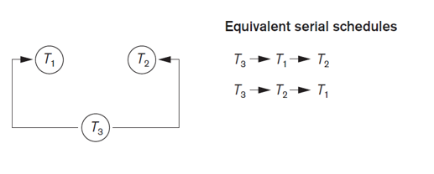

Slide 21
Consider the following schedules involving two transactions. Which one of the following statements is true?
S1: R₁(X) R₁(Y) R₂(X) R₂(Y) W₂(Y) W₁(X) S2: R₁(X) R₂(X) R₂(Y) W₂(Y) R₁(Y) W₁(X)
Both S1 and S2 are conflict serializable
Only S1 is conflict serializable
Only S2 is conflict serializable
None

Slide 22
Consider the following schedules involving two transactions. Which one of the following statements is true?
S1: R₁(X) R₁(Y) R₂(X) R₂(Y) W₂(Y) W₁(X) S2: R₁(X) R₂(X) R₂(Y) W₂(Y) R₁(Y) W₁(X)
Both S1 and S2 are conflict serializable
Only S1 is conflict serializable
Only S2 is conflict serializable
None

Slide 23
Check whether its conflict serializable

Slide 24
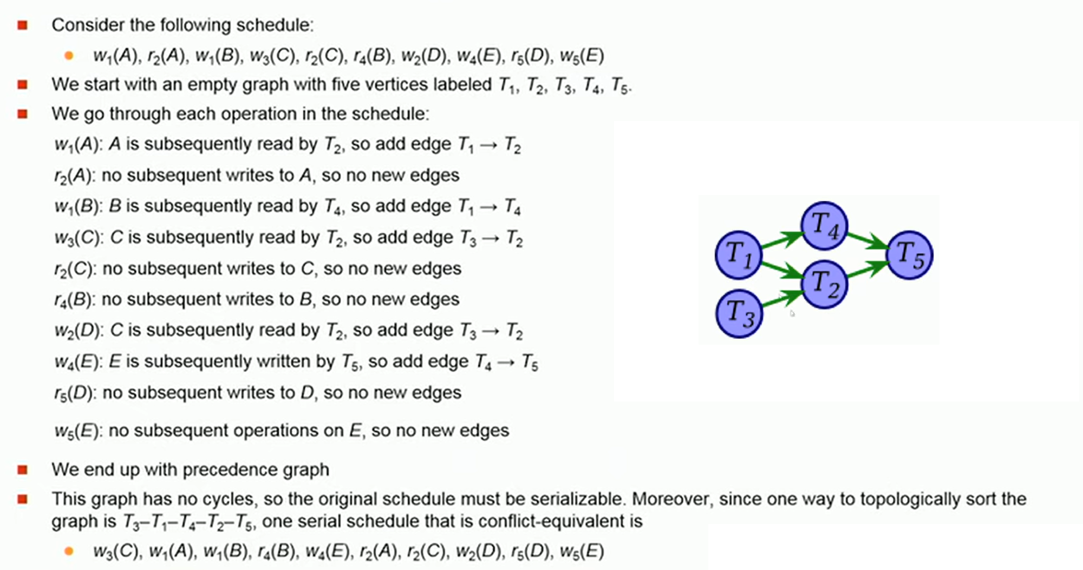
Check whether its conflict serializable

Slide 25
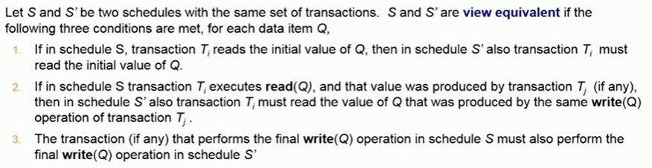
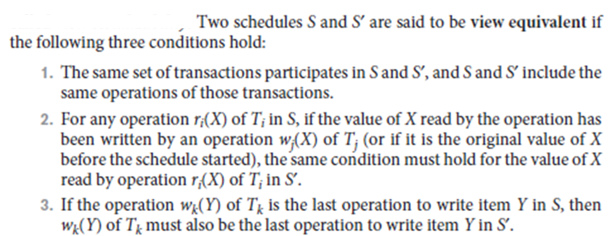
View Serializability

Slide 26
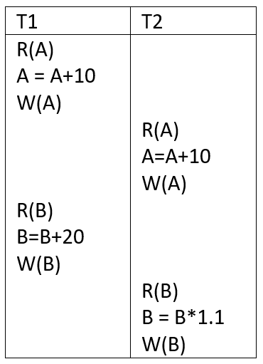
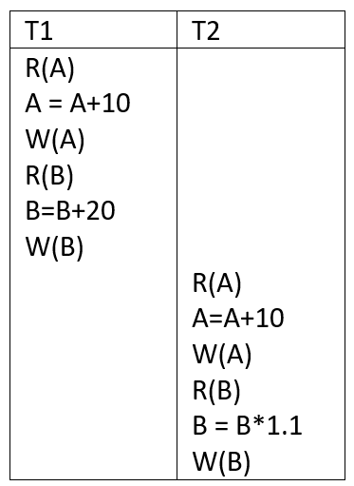
View equivalent schedules

Slide 27
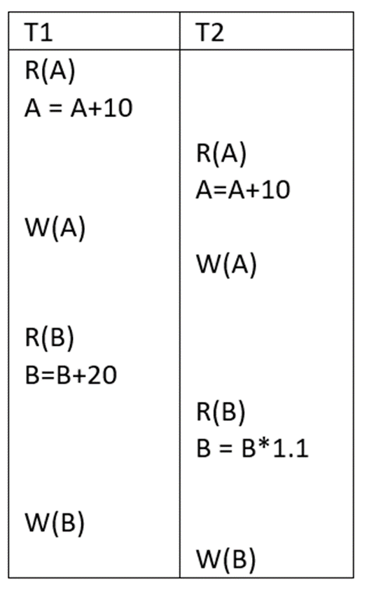
Not view equivalent schedules

Slide 28
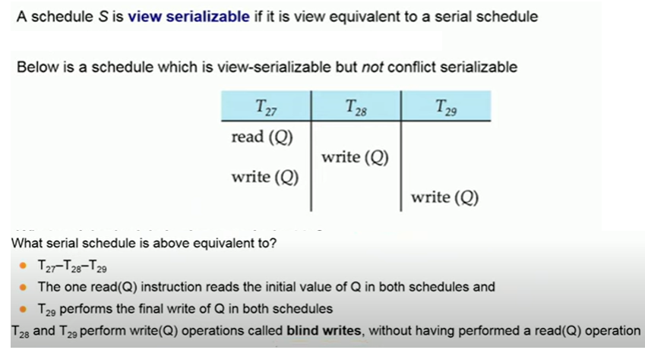

Slide 29
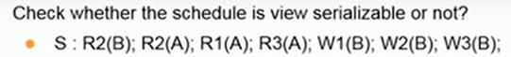

Slide 30
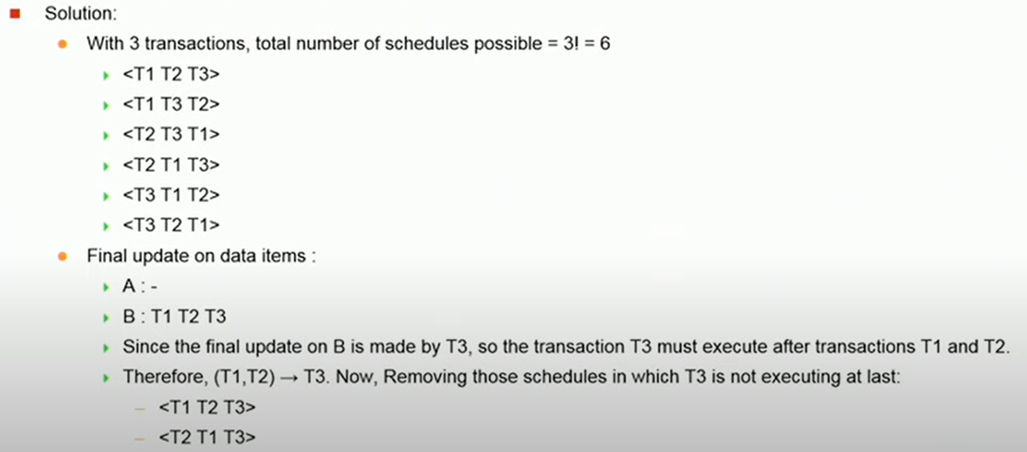

Slide 31
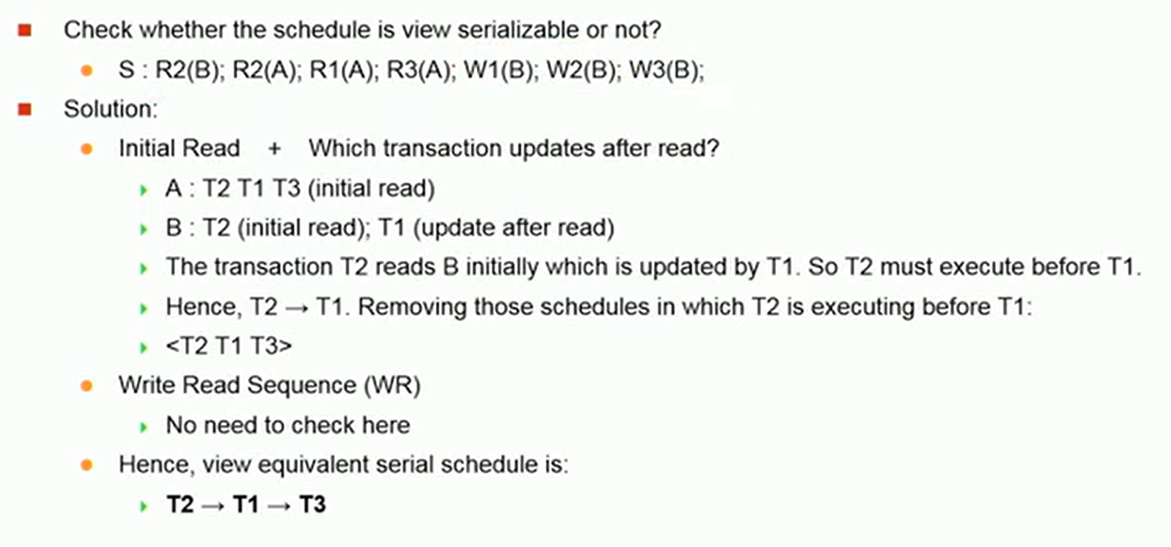

Slide 32
S2 : r1(X),w2(X),r3(X),w1(X),w3(X)

Slide 33
S1 : r1(X),r2(Y),w1(X),r2(Y),w3(y),w1(X),r2(Y)

Slide 35
For S2: T1 T2 T3 ( Equivalent serial schedule, so view serializable)
For S : T1 T2 T3 T4 ( equivalent serial schedule, , so view serializable)
S1 is Not view serializable. (T3 then T2 to preserve write read dependency in Y but T3 then T2 will change the initial read property of T2 for Y.

